Slide 1
Image captioning with flickr8k dataset
NLP project

Slide 2
What is Image Caption Generator?
Image caption generator is a task that involves computer vision and natural language processing concepts to recognize the context of an image and describe them in a natural language like English.

Slide 3
About flickr8k dataset
The Flickr8k dataset is a collection of 8,092 images with up to five captions for each image. The dataset is available in English and can be used for tasks such as image-to-text and text-to-image. The captions are provided by five different people, as an image can be described in multiple ways.
In Flickr_8K dataset, all the images of training, validation and test set are in one folder.
It contains 3 different files i.e Flickr_8k.trainImages.txt,Flickr_8k.testImages.txt, Flickr_8k.devImages.txt corresponding to each type of dataset i.e train, test and validation set, each file having file_name of images conatined in each dataset.
Each image is given 5 different captions by 5 different humans. This is because an image can be described in multiple ways.These captions are stored in 'Flickr8k.token.txt'.

Slide 4
Model used
ResNet-50
LSTM

Slide 5
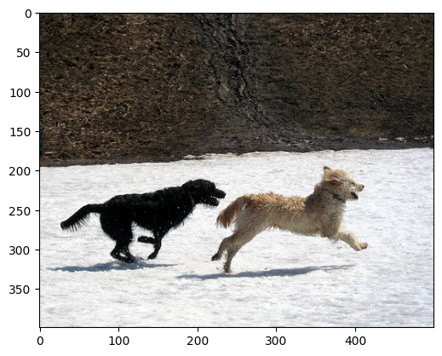
Data visualization and preprocessing
visualising one of the train images
img=cv2.imread("all_images/Flicker8k_Dataset"+ "/" +train_image_names.img_id[0])
plt.imshow(cv2.cvtColor(img,cv2.COLOR_BGR2RGB))

Slide 6
Displaying first 5 image names
train_image_names.head()
Image-id
0 | 2513260012_03d33305cf.jpg
1 | 2903617548_d3e38d7f88.jpg
2 | 3338291921_fe7ae0c8f8.jpg
3 | 488416045_1c6d903fe0.jpg
4 | 2644326817_8f45080b87.jpg

Slide 7
Creating training, testing and validation dictionaries to map image_id and their corresponding captions.
train_captions={}
for i in tqdm(range(len(train_image_names))):
l=[caption for caption in(image_tokens[image_tokens["img_id"]==train_image_names["img_id"].iloc[i]].img_caption)]
train_captions[train_image_names["img_id"].iloc[i]]=l

Slide 8
ResNet50 model for encoding images
ResNet50 was used as an image encoder to encode the images which were then input in the model.
Keras embedding layer was used to generate word embeddings on the captions which were encoded earlier.
The embeddings were then passed into LSTM after which the image and text features were combined and sent to a decoder network to generate the next word.

Slide 9
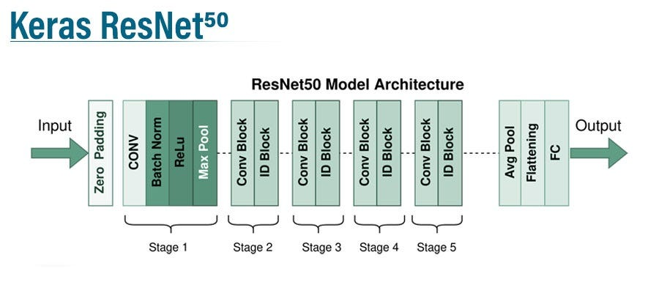
ResNet-50

Slide 10
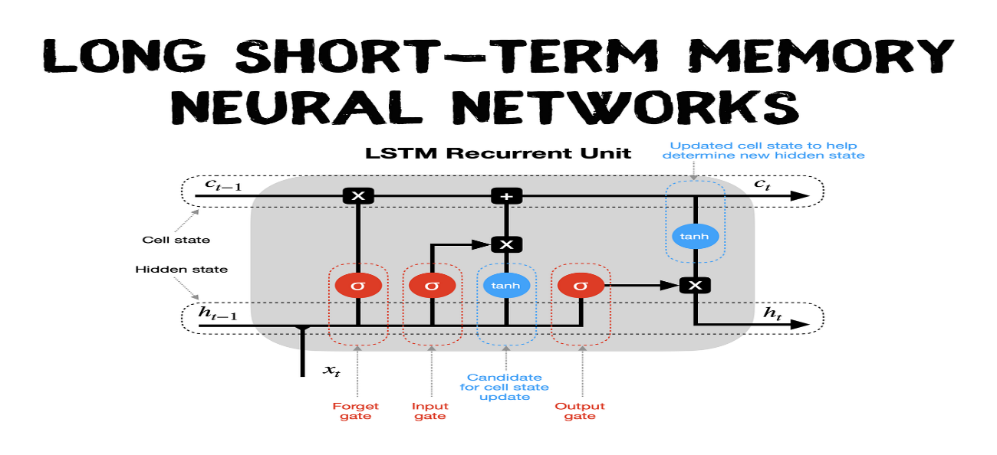
LSTM
Long short-term memory (LSTM) is a type of recurrent neural network (RNN) aimed at dealing with the vanishing gradient problem present in traditional RNNs.

Slide 11
Greedy search
Greedy search is a simple and intuitive algorithm used in problem-solving and optimization tasks. The core idea is to make the most favorable choice at each step with the hope of finding a global optimum.
Property: At each step, the algorithm chooses the best option available at that moment, without considering the consequences for future steps.
Efficiency: Greedy algorithms often have low time complexity because they do not explore all possible solutions. They focus on immediate gains.

Slide 12
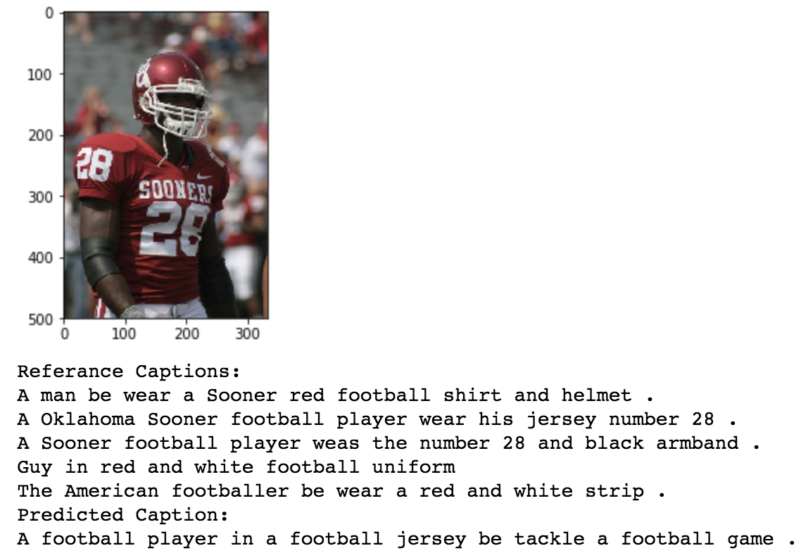
Results
Greedy Search is used to generate the captions.

